Slide 1

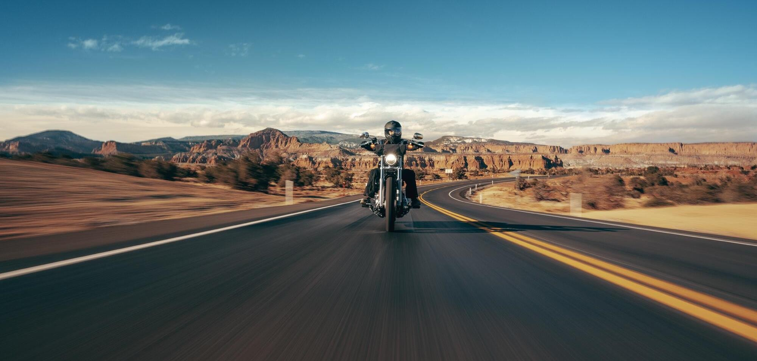


Harley Davidson
Group 6 - December 6, 2023

Slide 2
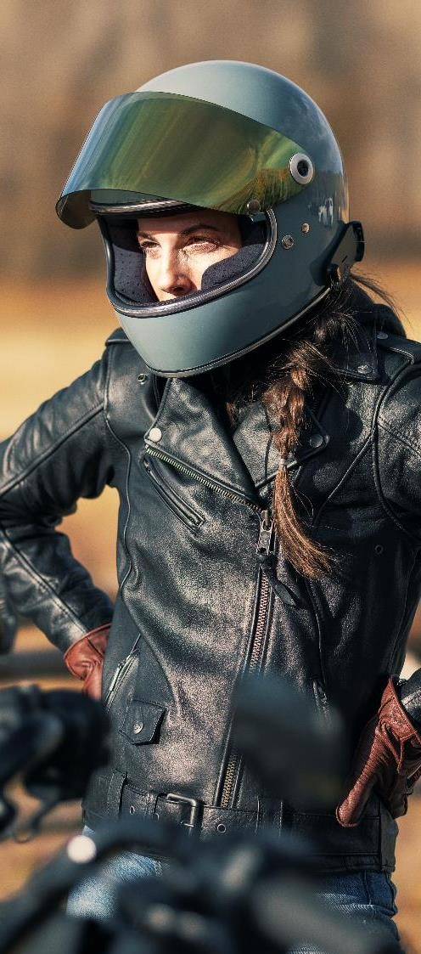



‘‘Where Tradition Meets Tomorrow in the Roar of Hybrid Power.’’
A strategic $74 M investment towards hybrid models. Harmonious blend of hybrid innovation and the timeless aesthetics that define Harley-Davidson.
RAKSHIT

Slide 3
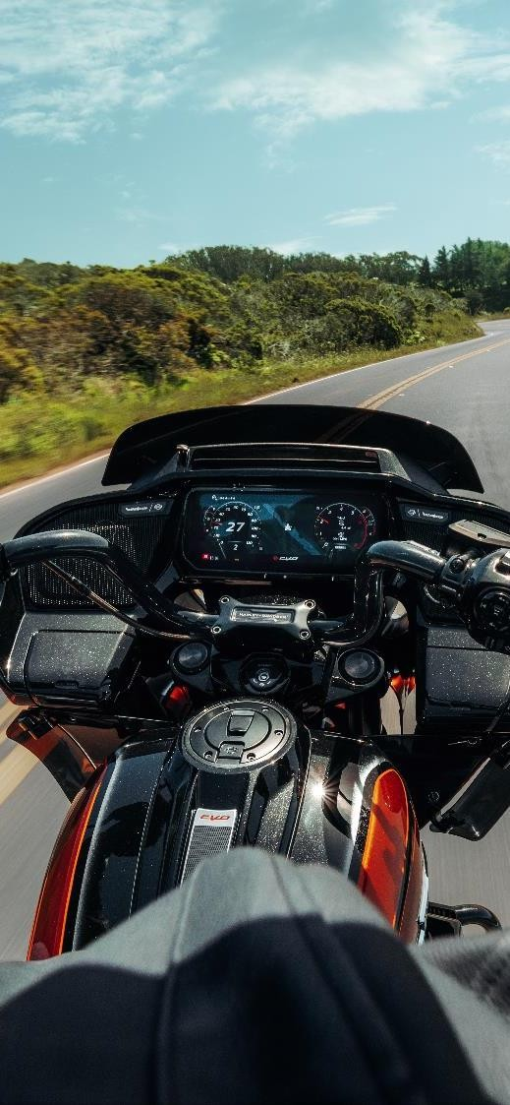

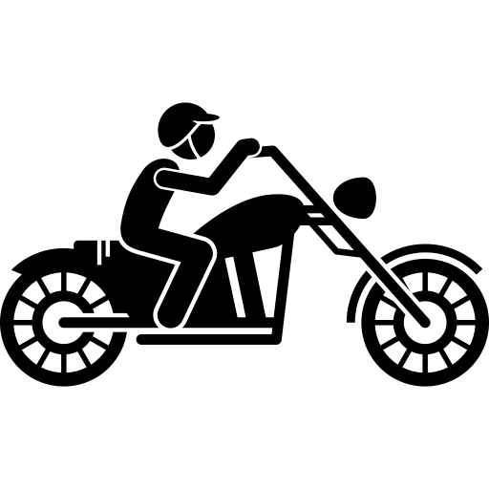
Agenda
Harley Davidson as a brand
LiveWire
Current market situation
Our idea- Hybrid
Financial feasibility
Benefits of hybrid design
Draw parallel
RAKSHIT

Slide 4
Spirit of freedom and rebellion
Capturing the essence of the open road
Harley-Davidson: Rumbling Legacy, Iconic Journey
Distinctive design elements
Teardrop fuel tank
Signature rumble of their exhaust.
RAKSHIT

Slide 5
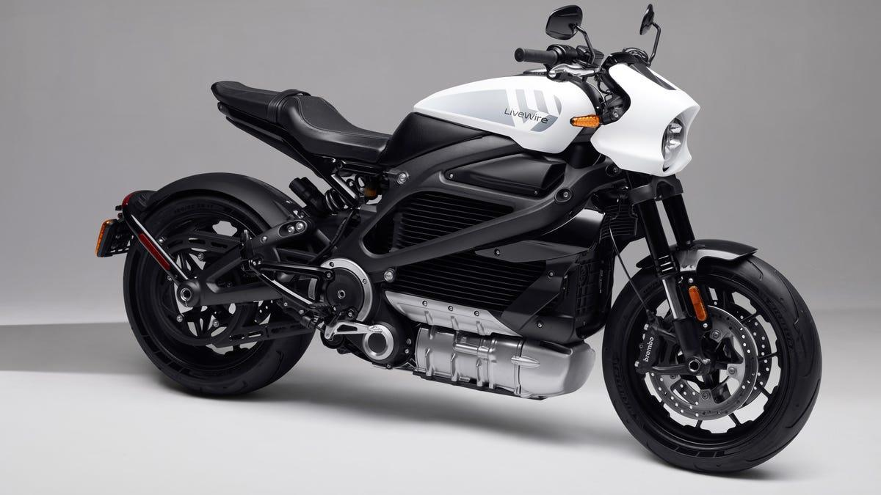
LIVEWIRE : Harley’s All Electric Adventure
Harley-Davidson's first electric motorcycle
1
LiveWire motorcycles often come equipped with Advanced Technology
2
S2 Del Mar : The Launch Edition of this model costs $17,699
3
RAKSHIT

Slide 6
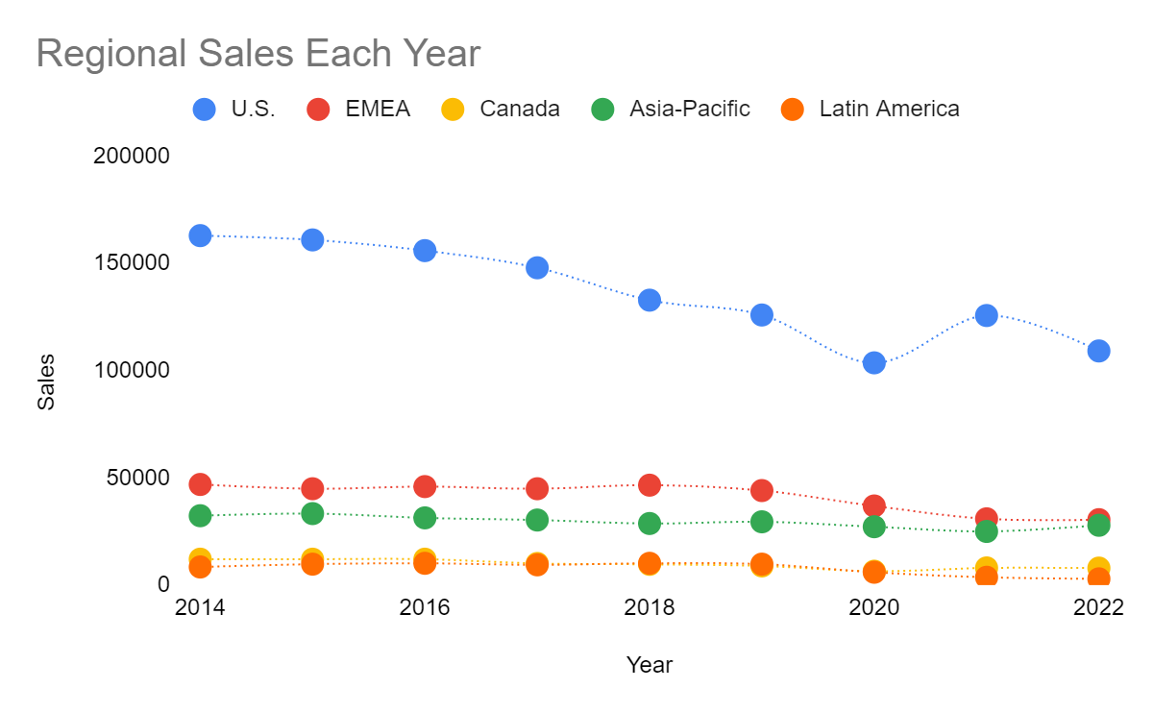
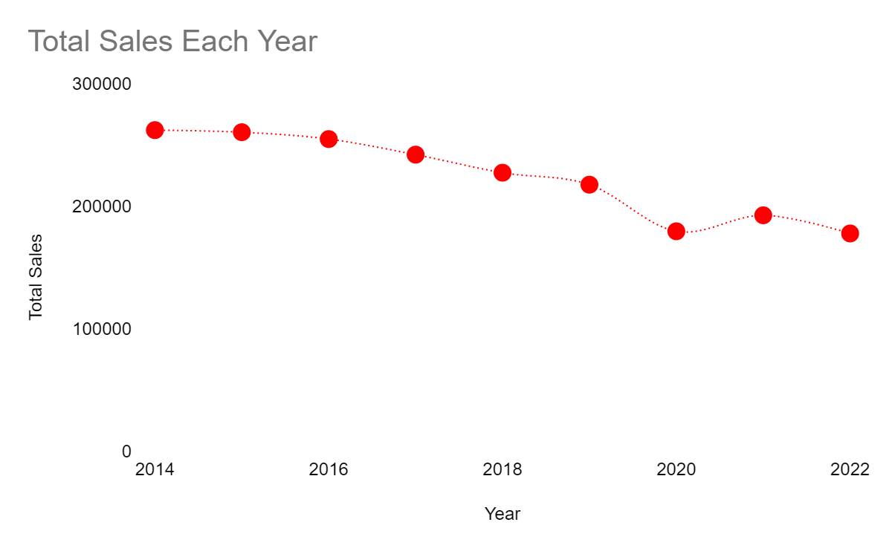
Declining Sales Trends
In 2023. After 9 months, global registrations have been 137,000 (-7.2%) one of the worse performance among the Top 20 world manufacturers.
SIDDHARTH

Slide 7
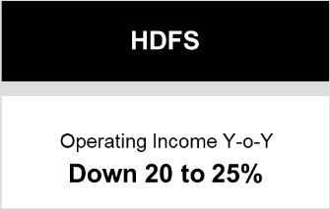
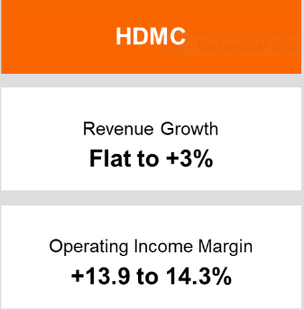
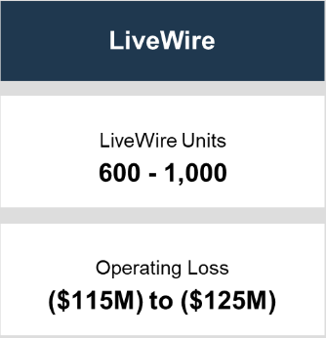
2023 HARLEY-DAVIDSON, INC. GUIDANCE
SIDDHARTH

Slide 8
2023 HARLEY-DAVIDSON, INC. GUIDANCE
$70M - $75M
SIDDHARTH

Slide 9
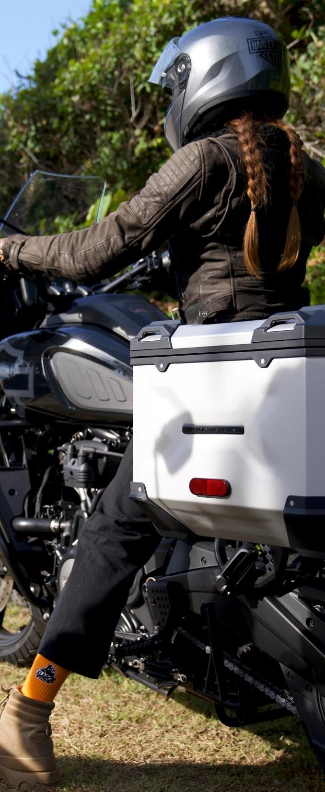
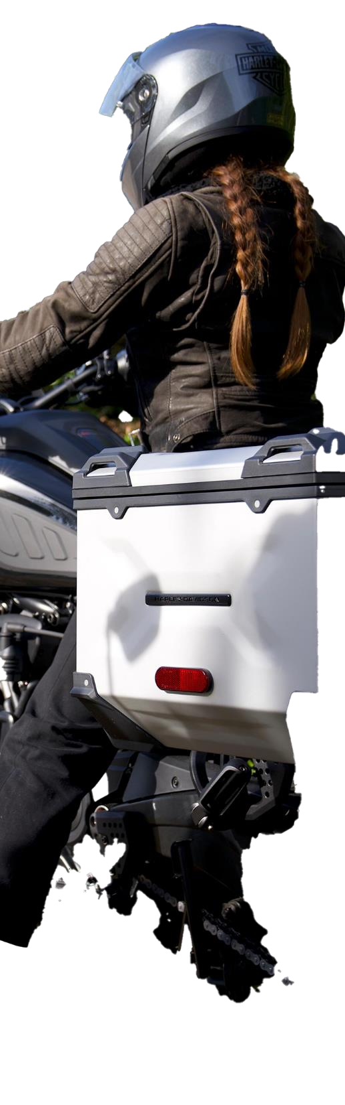


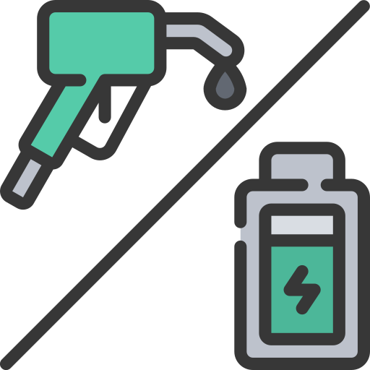

Curating A Harley Centric Mission
Paying employees with increased stock options
Increase cash reserves
Cash can be used to invest in Hybrid Push
CEO to employee pay ratio becomes 1:10
*CEO to employee pay ratio is 1:539
JAKE

Slide 10
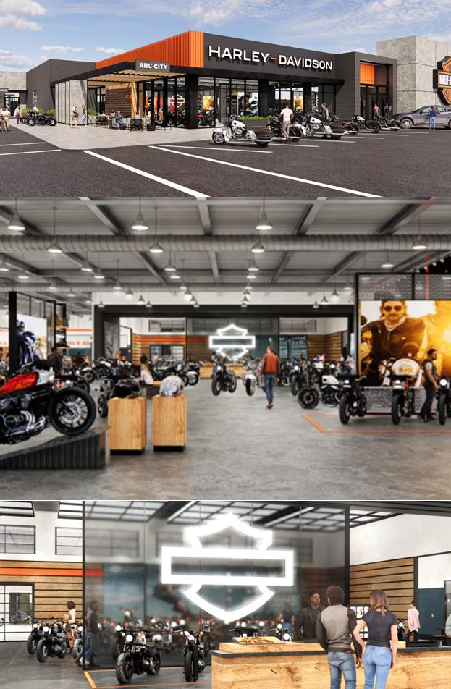



Investment in Our Culture
OVER
$1B in Treasury Stock
Current Administration
Expense:
$719 Million
After Stock Comp Move:
$647 Million
Median salary: $80,462
Stock Compensation: 10%
$71 Million in Cash added to balance sheet
Authorized to purchase 13.7 million additional shares
Opportunity for Harley-Davidson
JAKE
Notes:
Capacity for increased stock compensation

Slide 11



OUR IDEA
PROBLEM
SOLUTION
RESULT
Electric Harley - Old Aesthetics
= Loss of customer segment
= LOSS
Electric Harley + Old Aesthetics
= HYBRID DESIGN
HYBRID DESIGN
= Expanded Customer Segment
= PROFIT
SIMRAN

Slide 12
Internal combustion engine technology + electric propulsion system
Opens up exciting future prospects
Hybrid Design – ‘Where Tradition Meets Innovation.’
Timeless allure of traditional motorcycles with the sustainability and efficiency of modern technology
Option to use either the one or a combination of both
Signature rumble of their exhaust
SIMRAN

Slide 13

Hybrid Design : Shaping Tomorrow's Ride
Environmental
Stewardship
Extended Range and Efficiency
Adaptation to Regulatory Changes
1
2
3
4
5
Market Expansion
Innovation and Cutting-Edge Appeal
SIMRAN

Slide 14

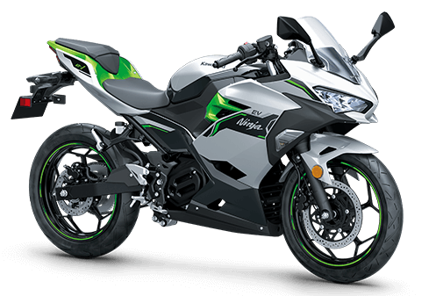



Is Hybrid Bike Possible?
Possibility of Hybrid Bike
Kawasaki Ninja 7 Hybrid, the first mass-production hybrid motorcycle
— Proposed launch in 2024
Retains the USP
Environmentally sustainable
KANIKA

Slide 15
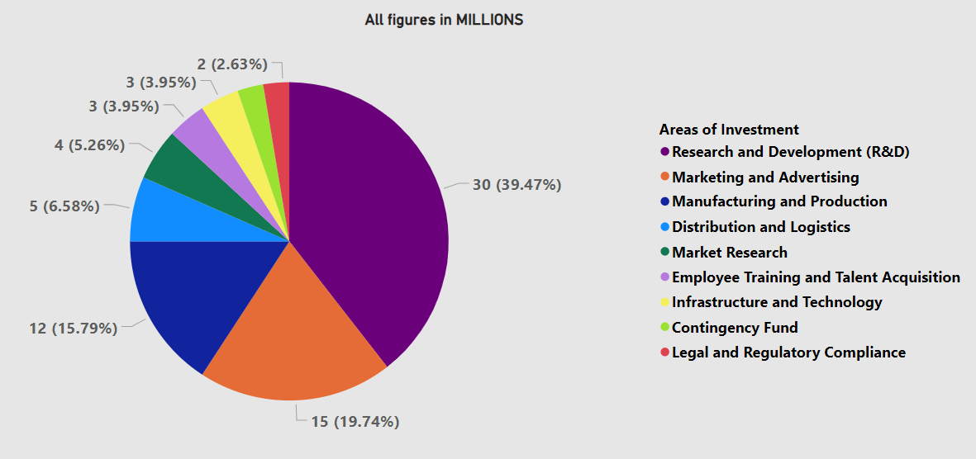
Revolutionary Ride: Piecing Together $74 Million for the Ultimate Hybrid Motorcycle Engine
KANIKA

Slide 16
Index
Harley Davidson as a brand
LiveWire
Current market situation
Financial feasibility
Our idea- Hybrid
Benefits of hybrid design
Draw parallel
RAKSHIT

Slide 17
THANK YOU

